Slide 1
Sustainability of Marine Aquaculture

Slide 2
…We are pleased to see food security highlighted as a priority area in the zero draft, as well as the determination to free humanity from hunger and to redouble efforts to eradicate poverty and hunger.
Rio+20 represents a unique opportunity to ensure that growth is green and benefits all. However, agriculture is central to this agenda: there can be no green economy without sustainable growth in agriculture², and a green economy will not contribute to sustainable development if it does not lift people out of hunger and poverty.
– FAO, IFAD, WFP, Biodiversity International

Slide 3
Facets of Sustainability
Sustainability of wild-caught fisheries
Sustainability of marine aquaculture in terms of yield
Sustainability of marine aquaculture in terms of energy and other resource inputs and outputs

Slide 4
Wild-Caught Fisheries
Overharvesting of target species
Bycatch
Destructive fishing practices
Growing global demand for animal protein

Slide 5
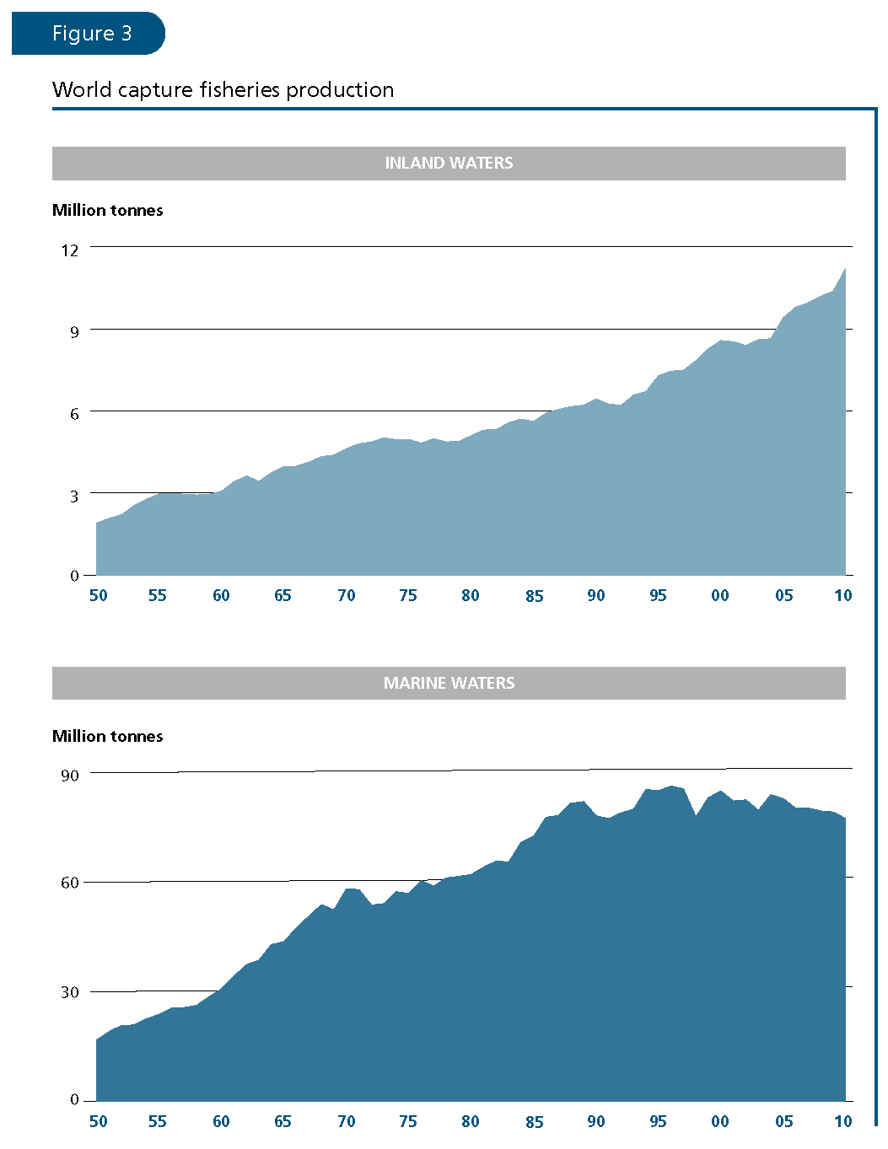

Slide 6
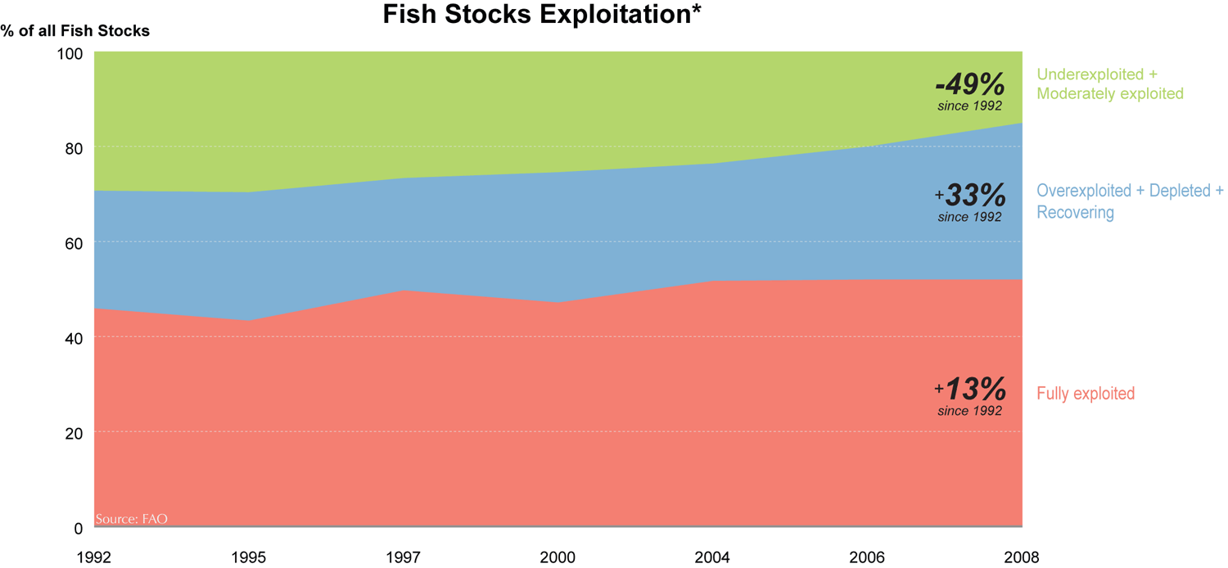

Slide 7
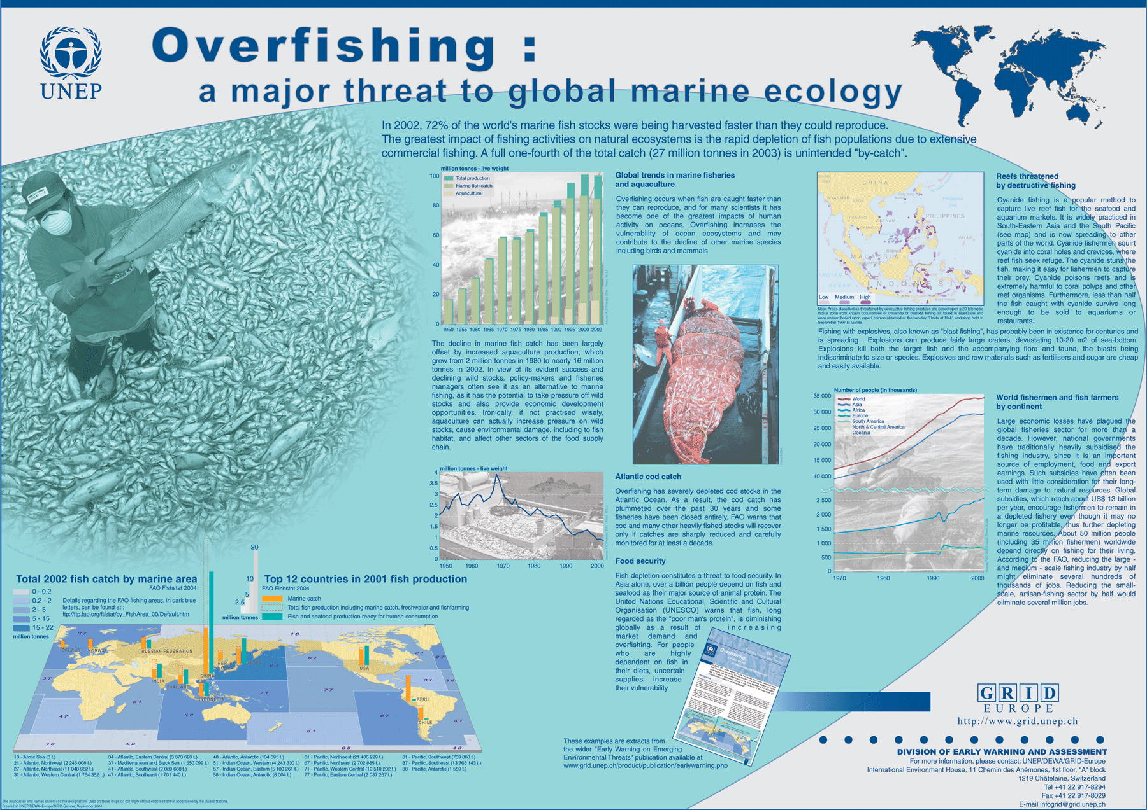

Slide 8
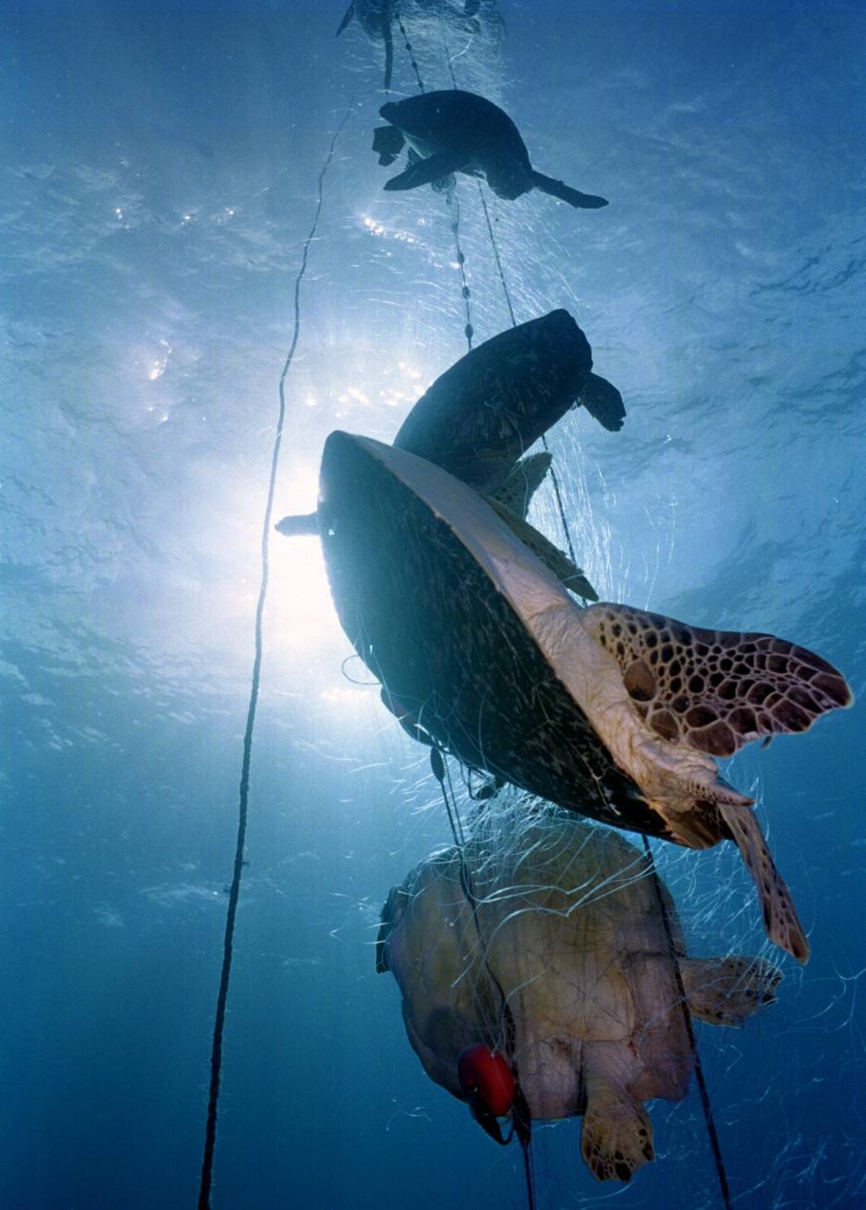
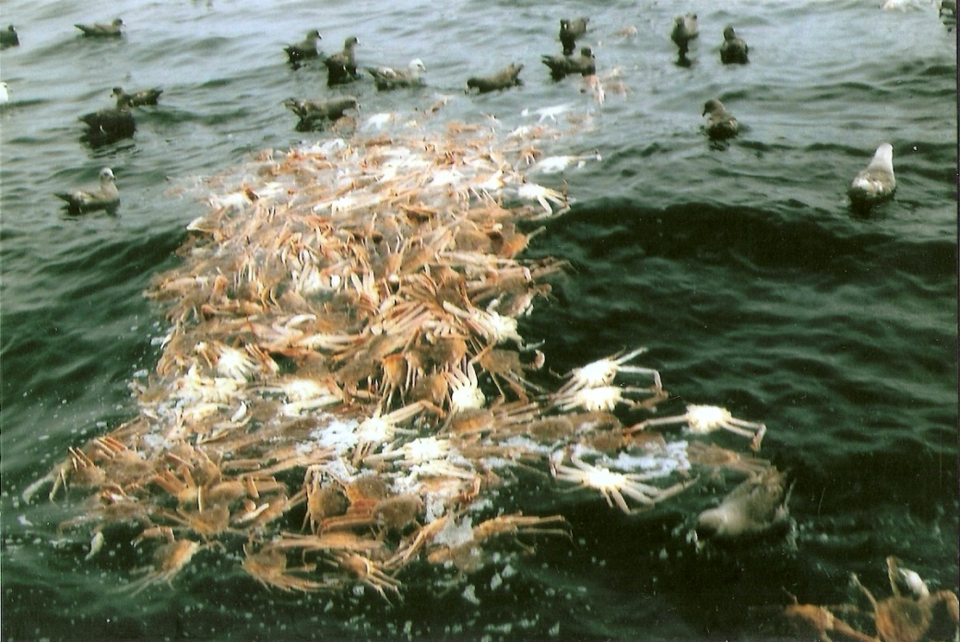

Slide 9
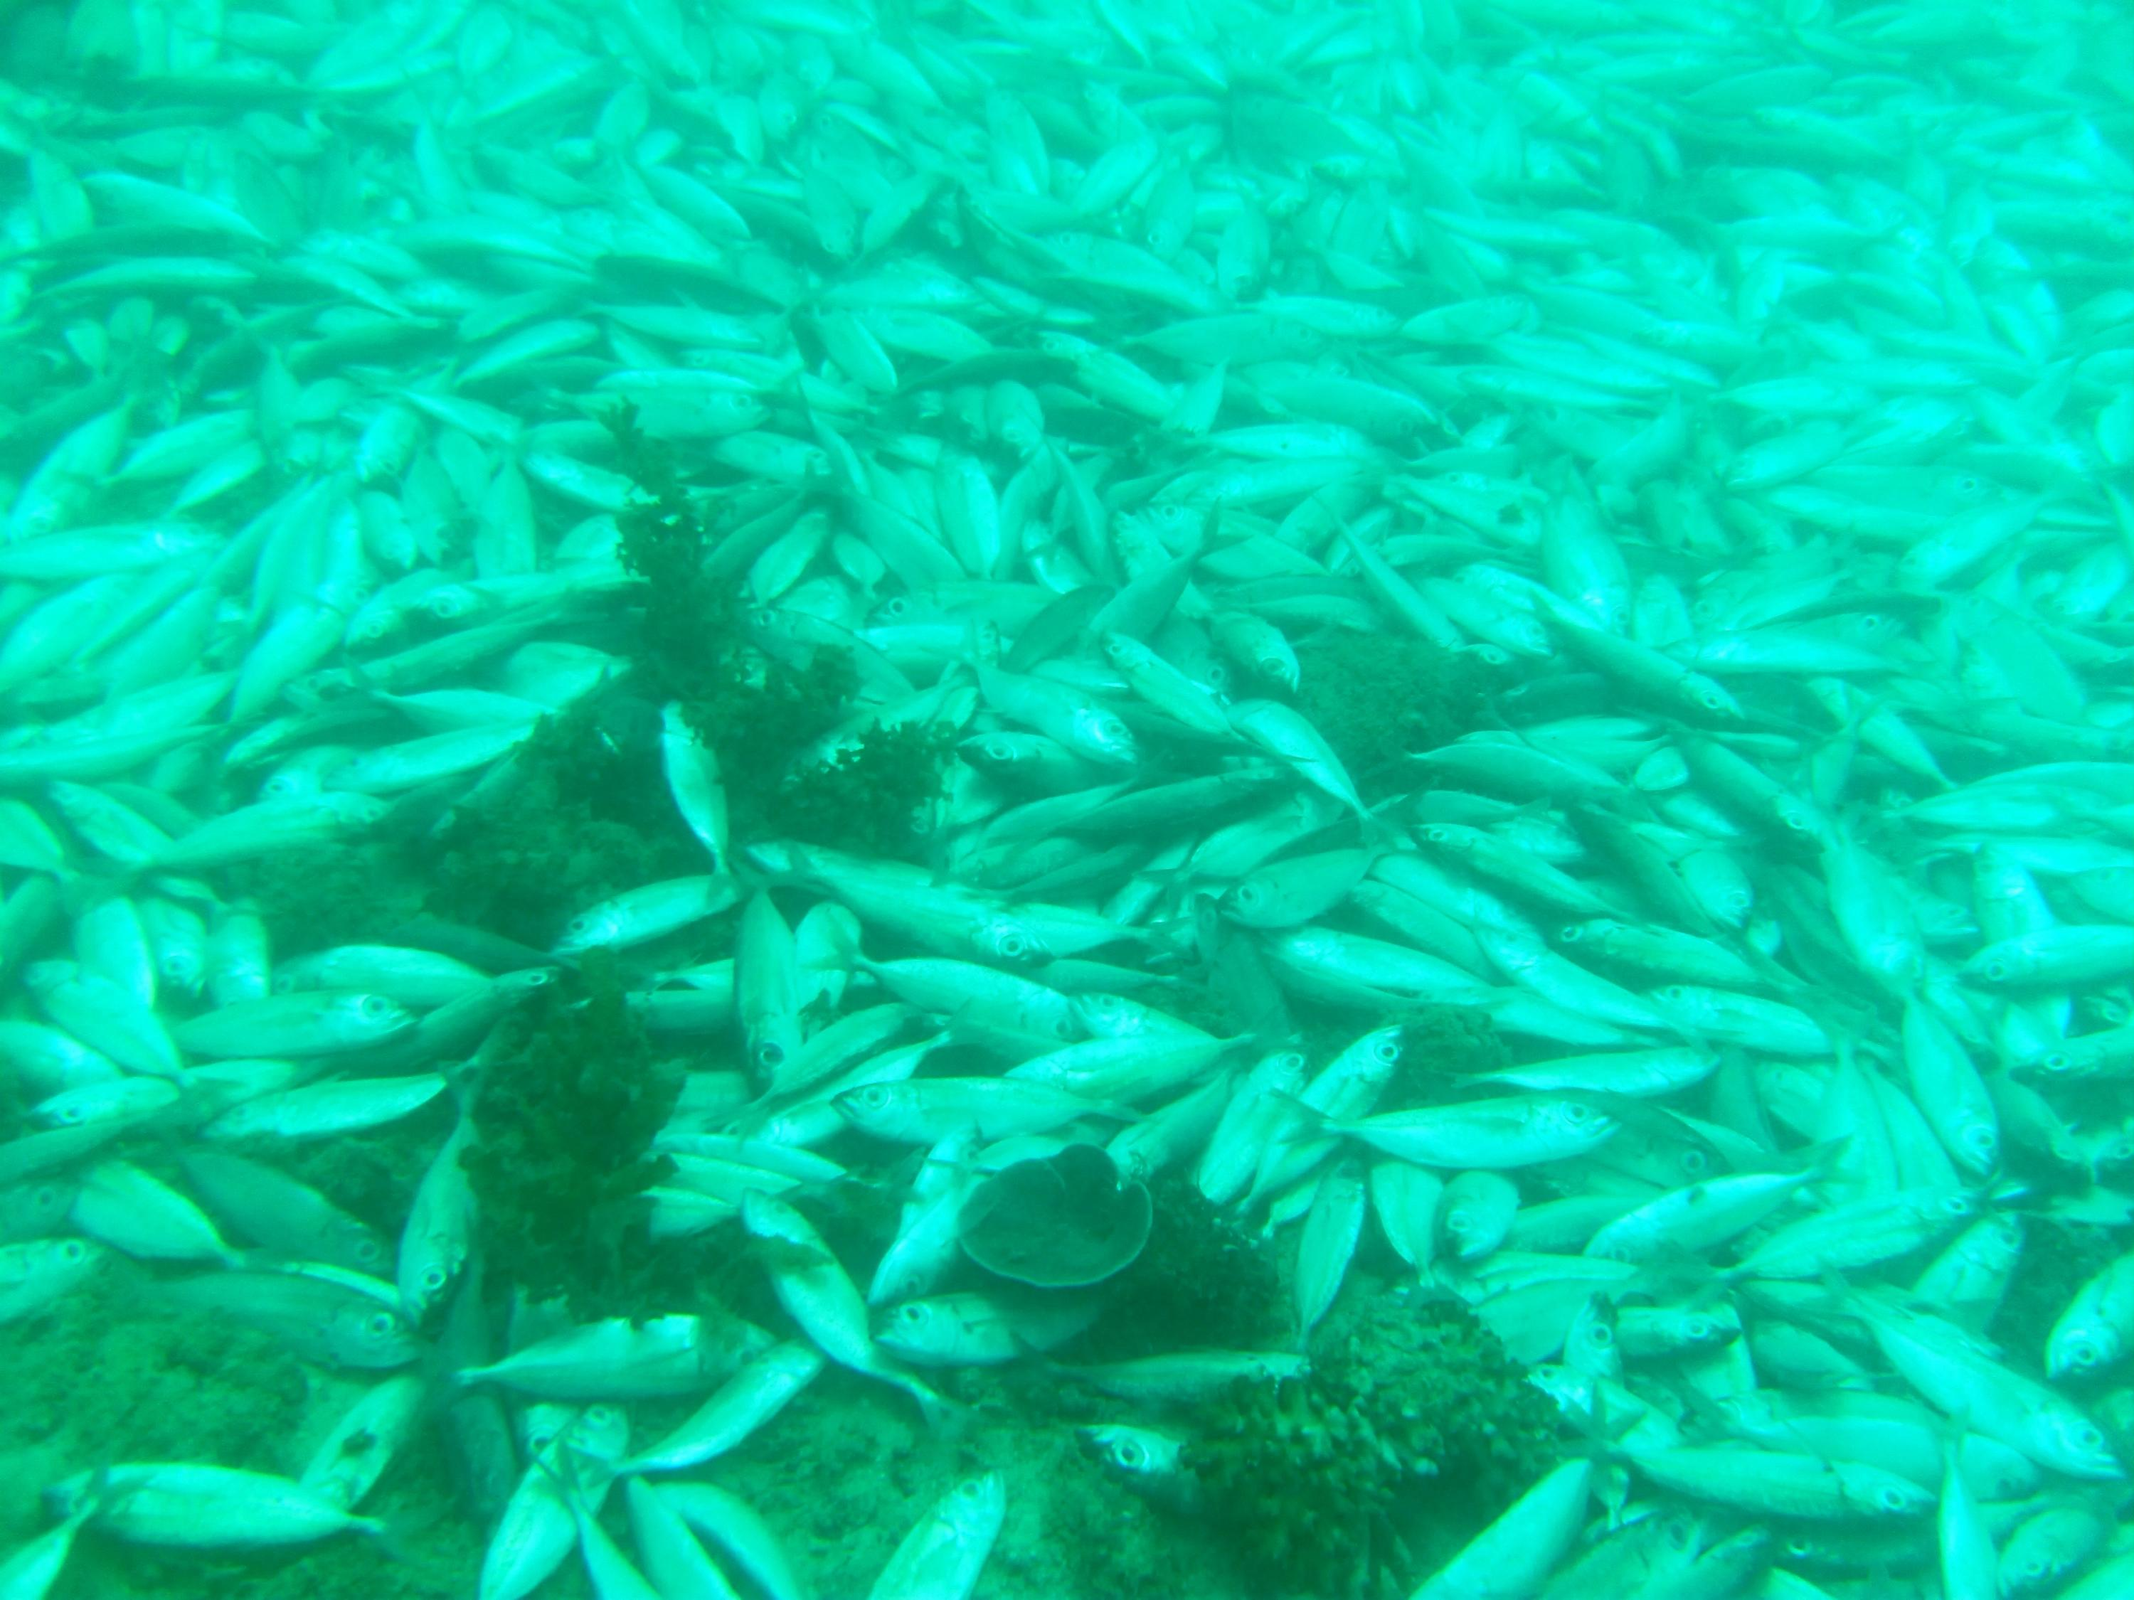

Slide 10
Benefits of Marine aquaculture
Offers a way to meet rising demand for animal protein while lessening dependence on wild-caught fisheries
Offers a way to minimize or eliminate bycatch
Offers a way to have sustained, though not necessarily sustainable, yield without recourse to destructive fishing practices

Slide 11
Sustainable Yield
Can marine aquaculture (and aquaculture in general) keep up with rising demand?
  Growth of marine aquaculture lags behind growth in freshwater aquaculture

Slide 12
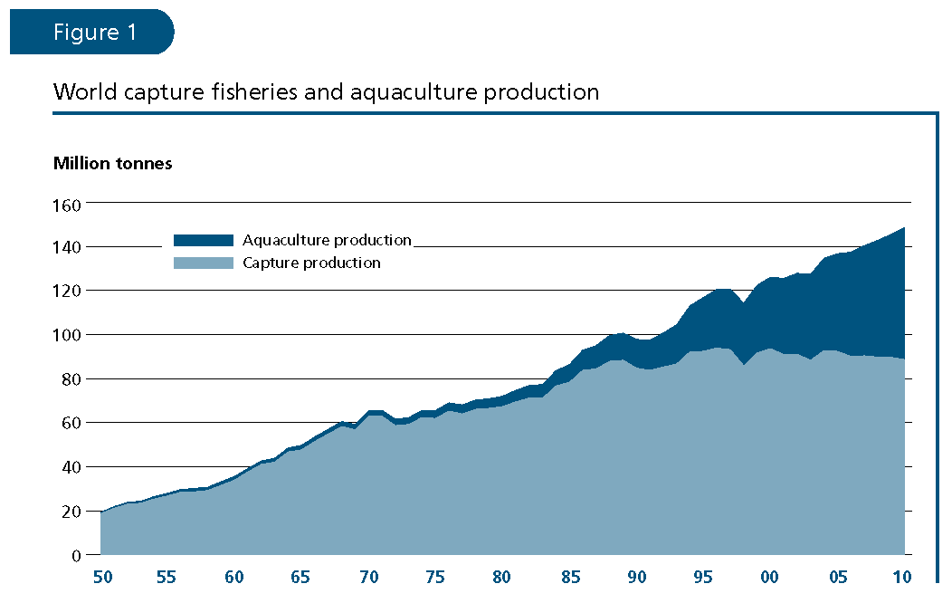

Slide 13
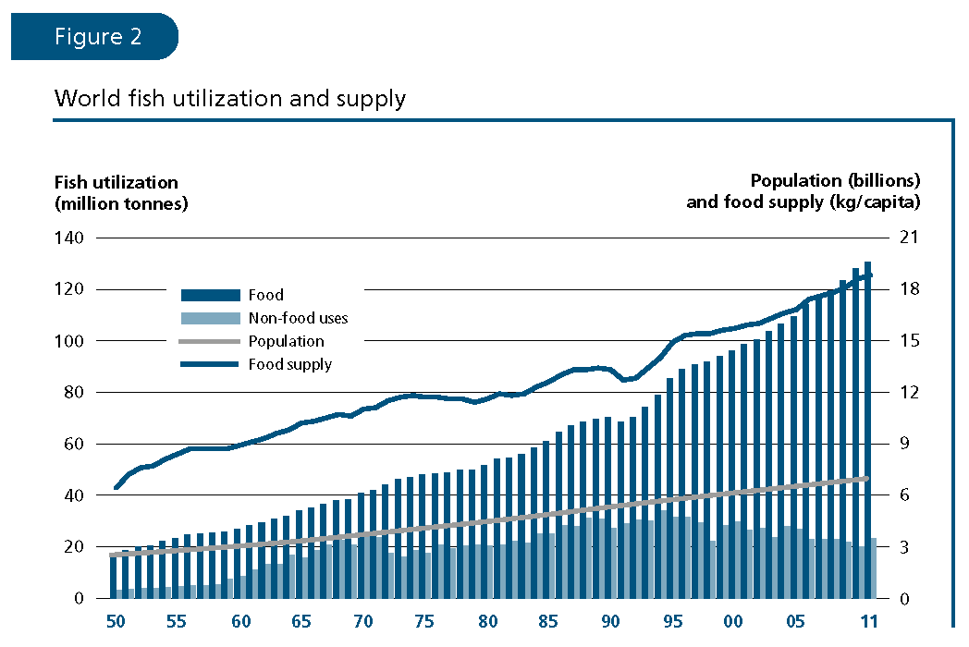

Slide 14
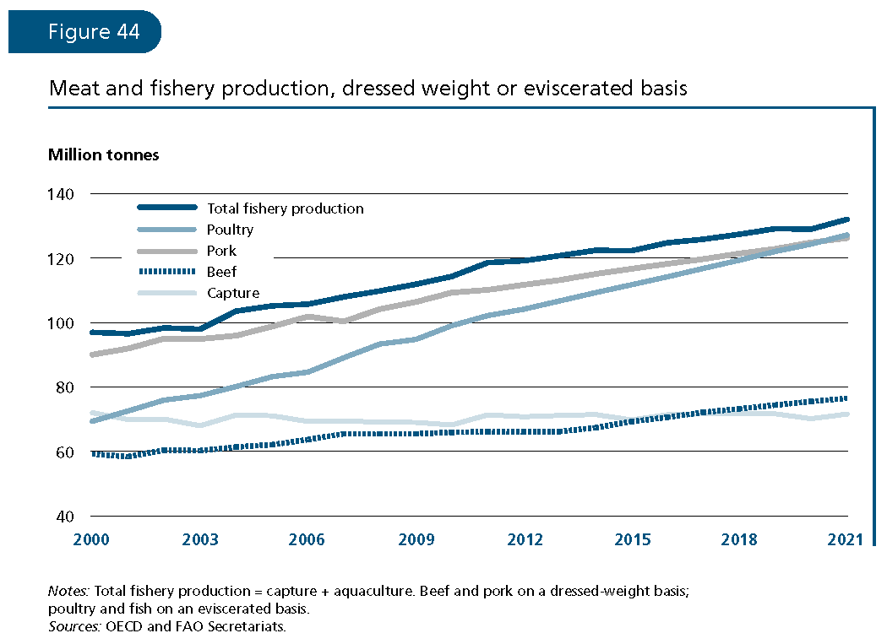

Slide 15
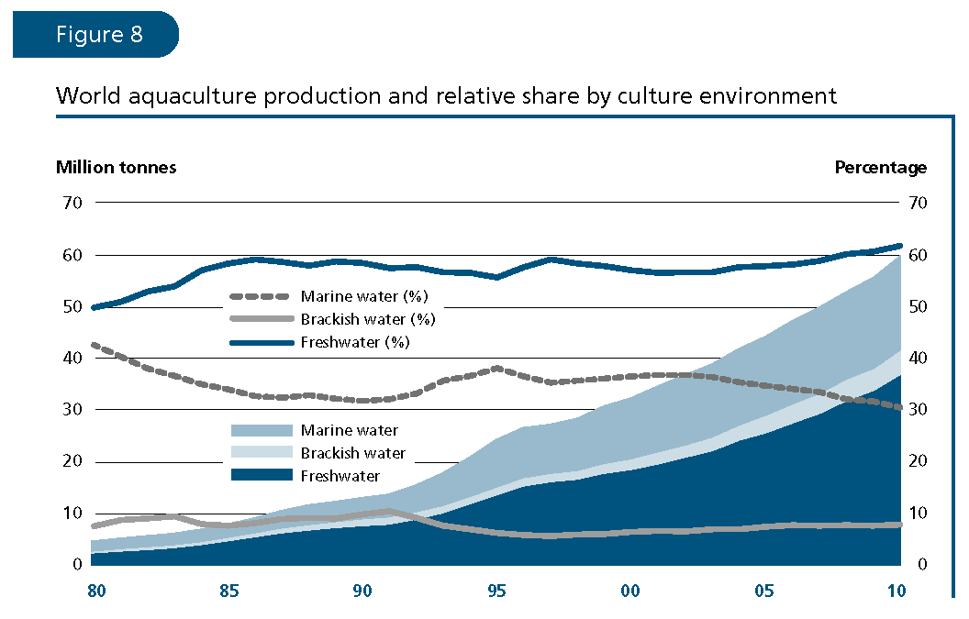

Slide 16
Balancing the Books
Marine aquaculture requires resource inputs: food, energy, drugs, etc.
  Percentage of species that require feeding will increase
  Use of captured feeds affects energy consumption
Energy consumption correlated with intensity of farming activity
Conversion of natural ecosystems (such as mangroves) to aquaculture

Slide 17
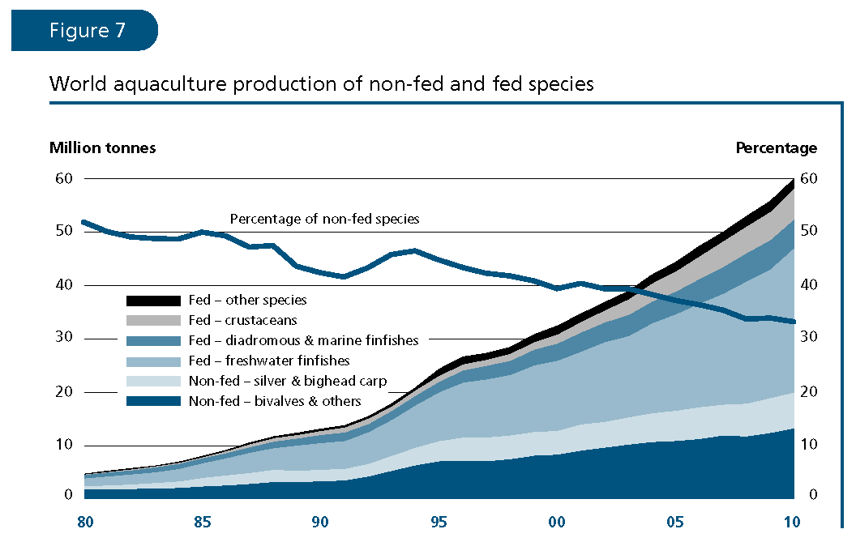

Slide 18
Energy relationships
Quantity | Seaweed culture | Mussel culture | Cage salmonid culture
energy inputs (kcal × 10⁵)
Solar/renewable (%) | 0.30 (4.5) | 0.75-2.05 (71.4-85.4) | 470-830 (81.0-87.4)
Fossil/non-renewable (%) | 6.35 (95.5) | 0.30-0.35 (28.6-14.6) | 110-120 (19.0-12.6)
Total energy | 6.65 | 1.05-2.40 | 580-950
Protein output (kcal) | 6605 | 255-440 | 22,420
Input/output ratio | 100 | 410-545 | 2585-4235
(From Bostoc et al., 2010. Aquaculture: Global Status and Trends

Slide 19
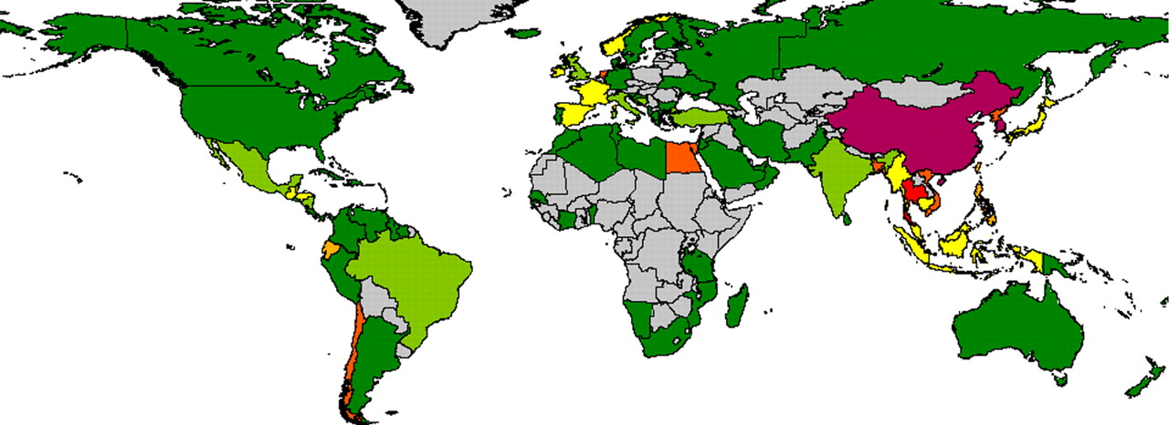
Mean production quantities from coastal aquaculture systems as function of coastline length (kg km⁻¹ yr⁻¹) for the period 2005-2007. Dark green, less than 10 kg km⁻¹ yr⁻¹; light green, 10–25 kg km⁻¹ yr⁻¹; yellow, 25–50 kg km⁻¹ yr⁻¹; light orange, 50–100 kg km⁻¹ yr⁻¹; dark orange, 100–250 kg km⁻¹ yr⁻¹; red, 250–500 kg km⁻¹ yr⁻¹; maroon, greater than 500 kg km⁻¹ yr⁻¹.

Slide 20
